Slide 1
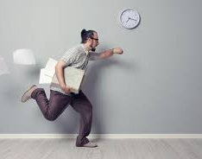
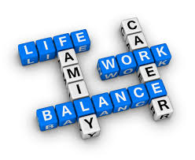
NAFEA
Cooley, D., Wheeldon, A, Pedersen, S., Tunny, R.

Slide 2
Who are we?
Notes:
Nearly all females
Well educated (46% post secondary school qualifications)
Mainly permanent full and part time
Tend to drink a little more than we should (more than 1 standard drink per day) and some of us meet the criteria for binge drinkers
Eat well although diet is somewhat restrictive
Suffer a range of aliments

Slide 3
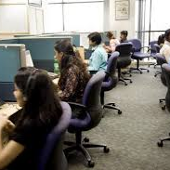
Notes:
Largely in non airconditioned environments, with little encouragement to personalise work space and little opportunity for job rotation
Work on average 41 hrs per week (F/T), although some worked more than 60hrs in the last week, with 21 hrs per week spent on administration

Slide 4
How healthy are we?
Notes:
8 per cent indicated that on some occasions, they would drink more than 6 standard drinks
Average daily amount was 3 standard drinks per day

Slide 5
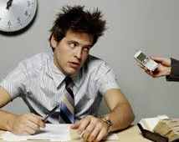
What is work like? How have things changed over the last 2 years?
Notes:
Work pressure has increased for the worse
Physical conditions are worse
Suggestions not listened to
Although some indicate all of these conditions are improving
About 65% of us report that work is stressful or heavily stressful, with 10% reporting that they cannot sustain the effort
Most are resilient and report completing work tasks despite interference with personal health issues
On average, we missed 5 days on average over the last 4 weeks because of health issues
About 30% of us report our health is worse now than 12 months ago
About 30% report health adversely effecting leisure and work activities
About 26% report emotional health adversely effected their normal activities in the 7 days before the survey
66% reported daily bodily pain adversely effected their normal activities in the 7 days before the survey

Slide 6
Health Wellness Categories
Worried Well – relative few unhealthy conditions but low perceived health
Truly Health – few unhealthy conditions and high perceived health
Health Evaders relative large number of unhealthy behaviours & low perceived health
Health Illusionists relative large number of unhealthy behaviours but high perceived health
Notes:
The four health wellness segments are:
• The “Worried Well” – Those with relatively few unhealthy behaviors but low perceived health.
• The “Truly Healthies” – Those with relatively few unhealthy behaviors and high perceived health.
• The “Health Evaders” – Those with a relatively large number of unhealthy behaviors and low perceived health.
• The “Health Illusionists” – Those with a relatively large number of unhealthy behaviors but high perceived health.
• “Worried Well” Fewer unhealthy behaviors (1-4 items) and lower perceived health (“1-8”)
• “Truly Healthies” Fewer unhealthy behaviors (0-4 items) and perceived good health (“9”,”10”)
• “Health Evaders” More unhealthy behaviors (5+ items) and lower perceived health (“1-8”)
• “Health Illusionists” More unhealthy behaviors (5+ items) and perceived good health (“9”,”10”)

Slide 7
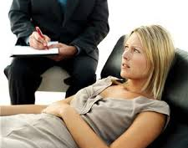
Worried Well
Relatively low perceived health (M=6.3 on a 10-point scale)
Less likely to have any of the conditions included in the survey.
Possible reason for their lower perceived health scores, is the proportion that say they are overweight or would like to loss 5 kg or more (24%).
Low work related stress factors
Most days look forward to going to work (57%)
Motivated by work (7.9 on a 10- point scale) and feel useful at work (8.0 on a 10- point scale)

Slide 8
Truly Healthy
This segment is the healthiest, in self-perception and reality.
The highest perceived health (8.4 on a 10-point scale)
Least likely to have any of the conditions included in the survey
Low work related stress factors - more satisfied with their jobs
Most days I look forward to going to work (53%)
High motivated by work (8.5 on a 10- point scale) and feel more useful at work (9.2 on a 10- point scale)

Slide 9
Health Evaders
A logical combination of lower perceived overall health with several potentially serious health conditions.
Lowest perceived health (4.9 on a 10-point scale) among all of the segments
High blood pressure (19%), high cholesterol (35%), a heart condition (12%), diabetes (13%), asthma (11%) arthritis (27%)
Nearly half say they are overweight (46%) – especially 15kg or more (66%)
less satisfied with their jobs
More likely to say their job makes them feel older than they are (19%) a
Less likely to look forward to going to work (54%) •
more likely to miss personal family activities (20%) and lose sleep (15%) because of their jobs
Less motivated (742 on a 10-point scale) and feel less useful (6.4 on a 10-point scale) at work than other segments

Slide 10
Health Illusionists
Despite reported health conditions, “Health Illusionists” believe they are very healthy overall
Among the highest perceived health (7.5 on a 10-point scale) among all of the segments
More likely to suffer from arthritis (33%).
Also reported high blood pressure (17%) High cholesterol (18%)
One in four say they are overweight (41%) – especially 5-10KG or more (55%)
68% agree that they look forward to work on most days (more motivated to perform well at work (8.8 on a 10-point scale) and feel more useful at work (8.9 on a 10-point scale)

