Slide 1
Indigenous students/ Indigenous contexts: Issues for Field Experience Administrators
Helen McDonald
James Cook University

Slide 2
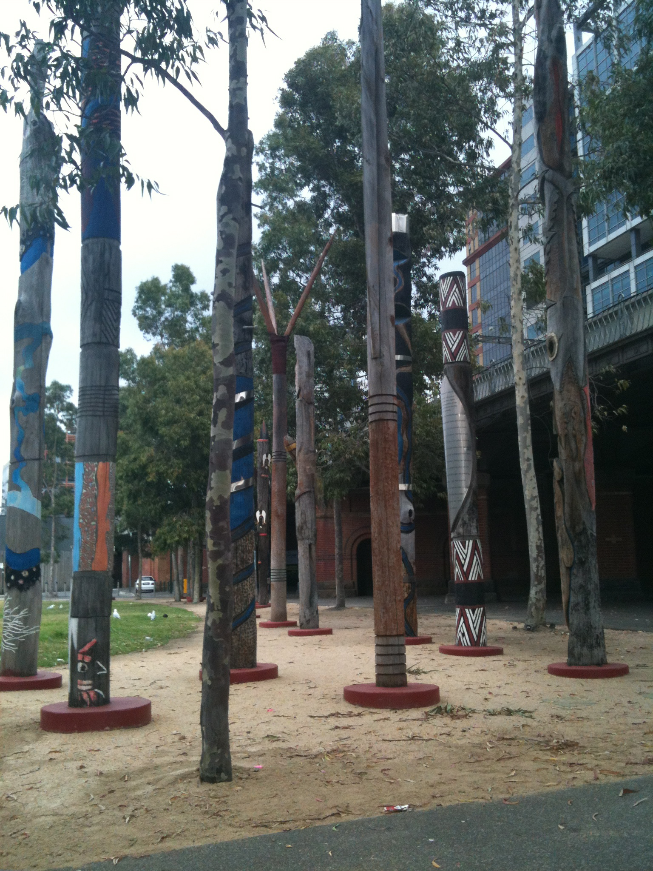
Acknowledgement of Country

Slide 3
The plan for today
Introduction: a bit of context
Aboriginal and Torres Strait Islander students in the academy? Who are they?
Implications for you
Sample WIL research study
Non-Indigenous students and Aboriginal and Torres Strait Islander placement contexts
Implications for you

Slide 4
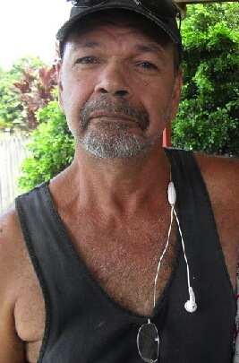
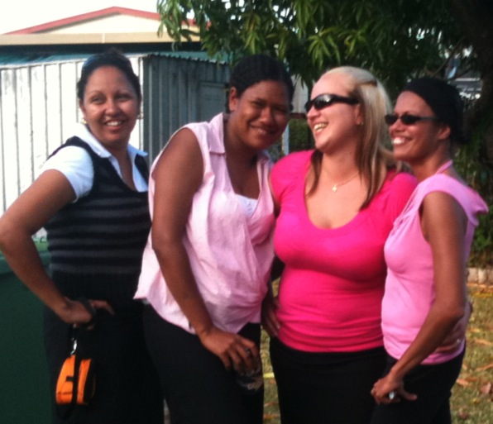
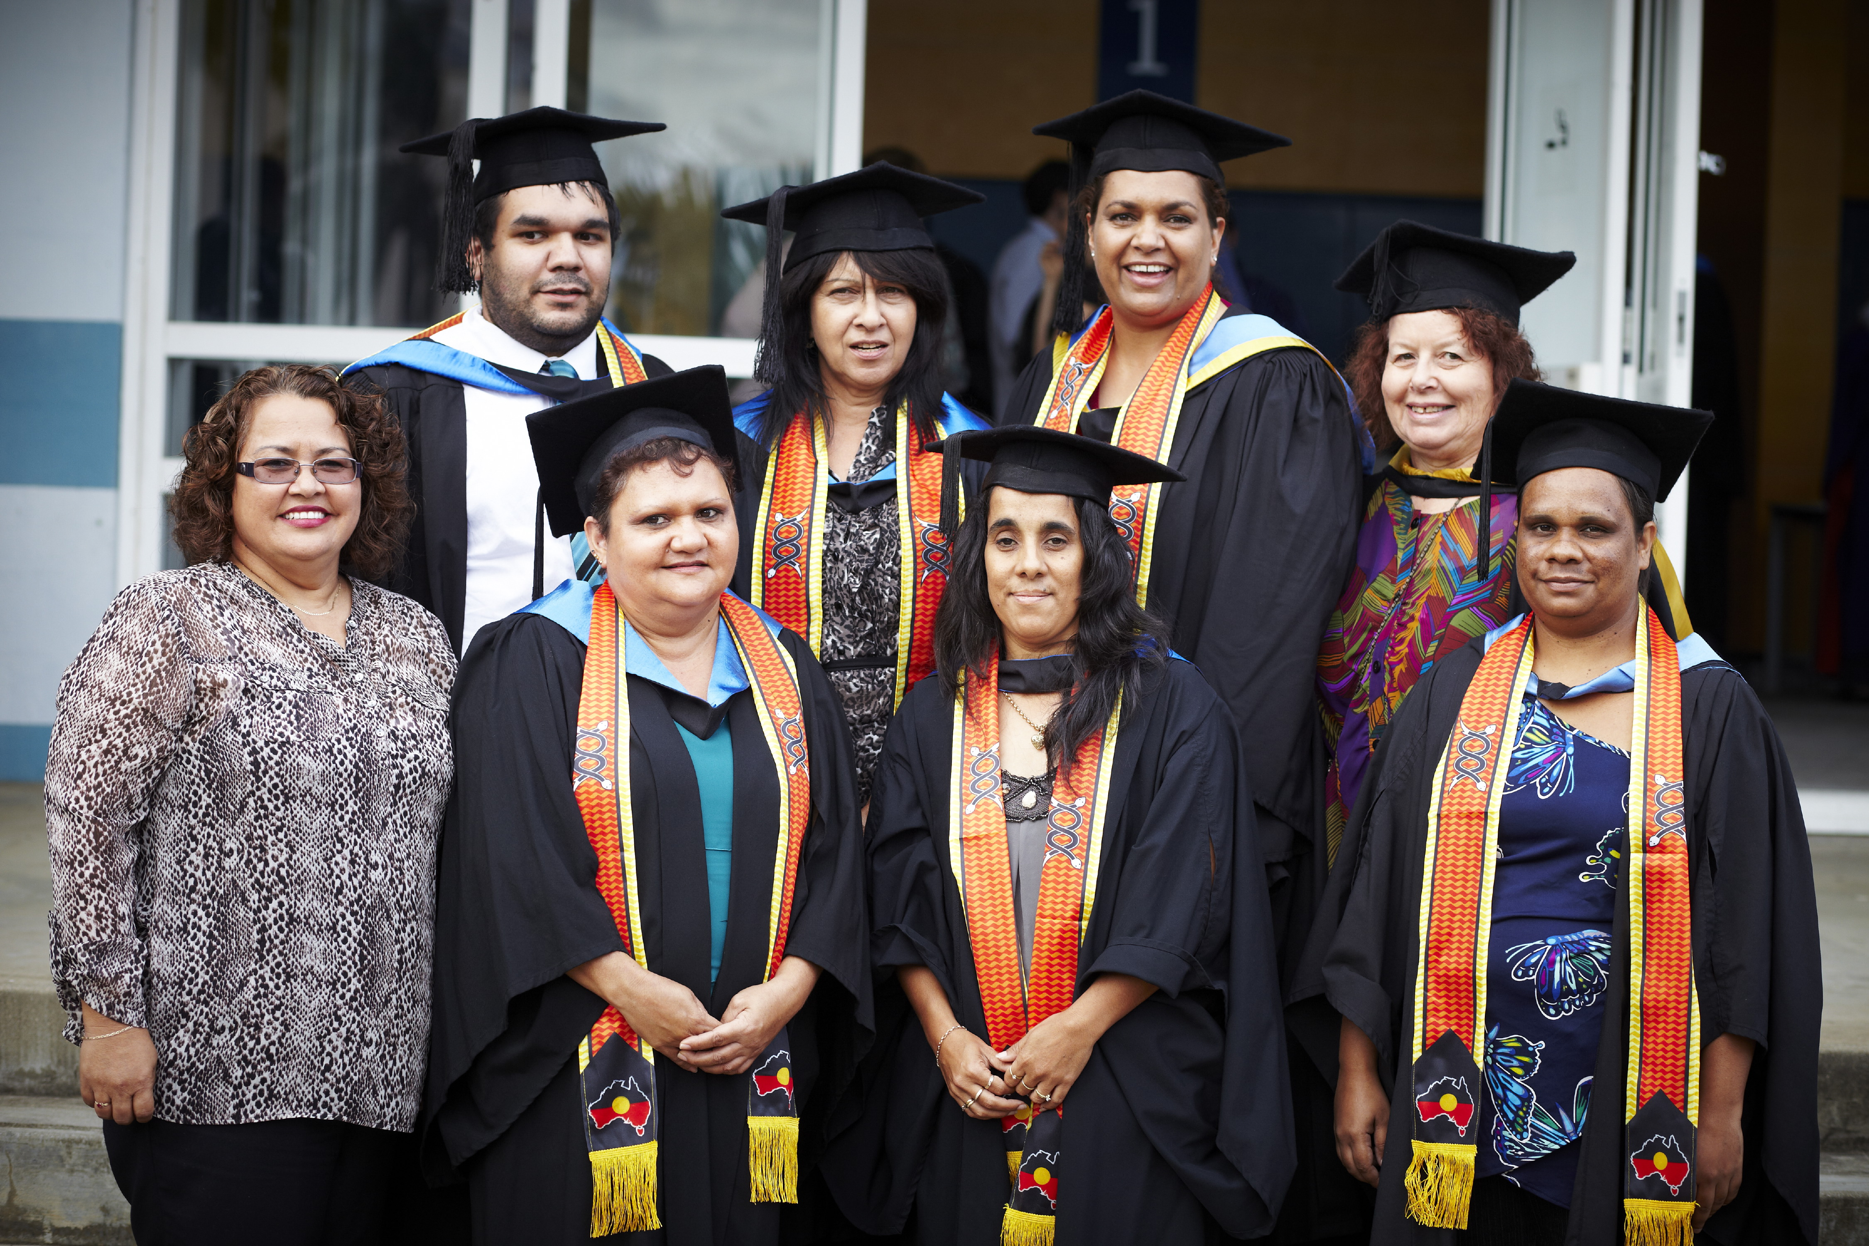
Who am I?

Slide 5
Who are you?

Slide 6
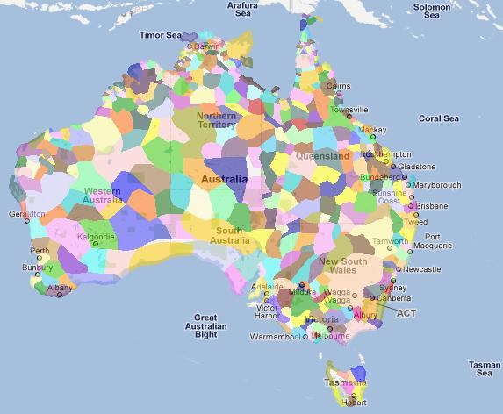
Context
www.abc.net.au/indigenous/map

Slide 7
From Behrendt report
Aboriginal and Torres Strait Islander students’ apparent school retention rates are lower compared to non-Indigenous students. 47.2% Indigenous cf 79.4% non-Indigenous
Aboriginal and Torres Strait Islander students are less likely to complete Year 12 compared to non-Indigenous students. 45.4% Indigenous cf 88.1% non-Indigenous
Aboriginal and Torres Strait Islander students are less likely to gain a university entrance score compared to non-Indigenous students. 10% Indigenous students who completed Year 12 gained a university entrance score, cf 46% of non-Indigenous
Notes:
. In 2010, 47.2% of Aboriginal and Torres Strait Islander students remained in school from the first year of high school to Year 12, compared to 79.4% of non-Indigenous students (SCRGSP 2011b, p. 4.58).
In 2008, 45.4% of Aboriginal and Torres Strait Islander 20- to 24-year-olds reported completing Year 12 or equivalent, compared to 88.1% of non-Indigenous 20- to 24-year-olds (SCRGSP 2011b, p. 4.49). In 2008, around 10% of Aboriginal and Torres Strait Islander students who completed Year 12 gained a university entrance score, compared to around 46% of non-Indigenous students (DEEWR 2008, pp. xxi, 35).

Slide 8
Aboriginal and Torres Strait Islander people are less likely to participate in the labour force compared to non-Indigenous people. 64.5% cf 78.9% of the non-Indigenous working-age population
Aboriginal and Torres Strait Islander people are more likely to have a lower median income compared to non-Indigenous people (over 18). $445 per week cf $746 per week

Slide 9
Aboriginal and Torres Strait Islander students made up 1.4% of all enrolments in university in 2010 – parity would be 2.2%
Aboriginal and Torres Strait Islander students are less likely to be admitted to university on the basis of their prior educational attainment compared to non-Indigenous students. 47.3% cf 83.0%
Aboriginal and Torres Strait Islander students are more likely to be mature-age students (aged 25 years and over) compared to non-Indigenous students. 54.4% cf 38.2%
Aboriginal and Torres Strait Islander students are more likely to use an external mode of attendance compared to non-Indigenous students. 27.4% cf 15.5%

Slide 10
Aboriginal and Torres Strait Islander student retention rates are lower compared to non-Indigenous students. 63.4% cf 79.8%
Aboriginal and Torres Strait Islander students have lower completion rates over a five-year period compared to non-Indigenous students. 40.8% cf 68
How do you explain these facts?

Slide 11
But …
What do you know about the Indigenous students in your program – and how do you know it?
What similarities and differences are there in your group?

Slide 12
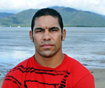
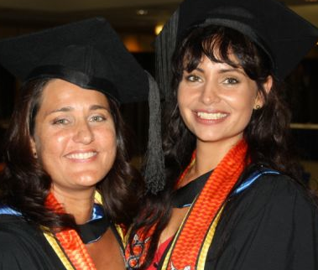
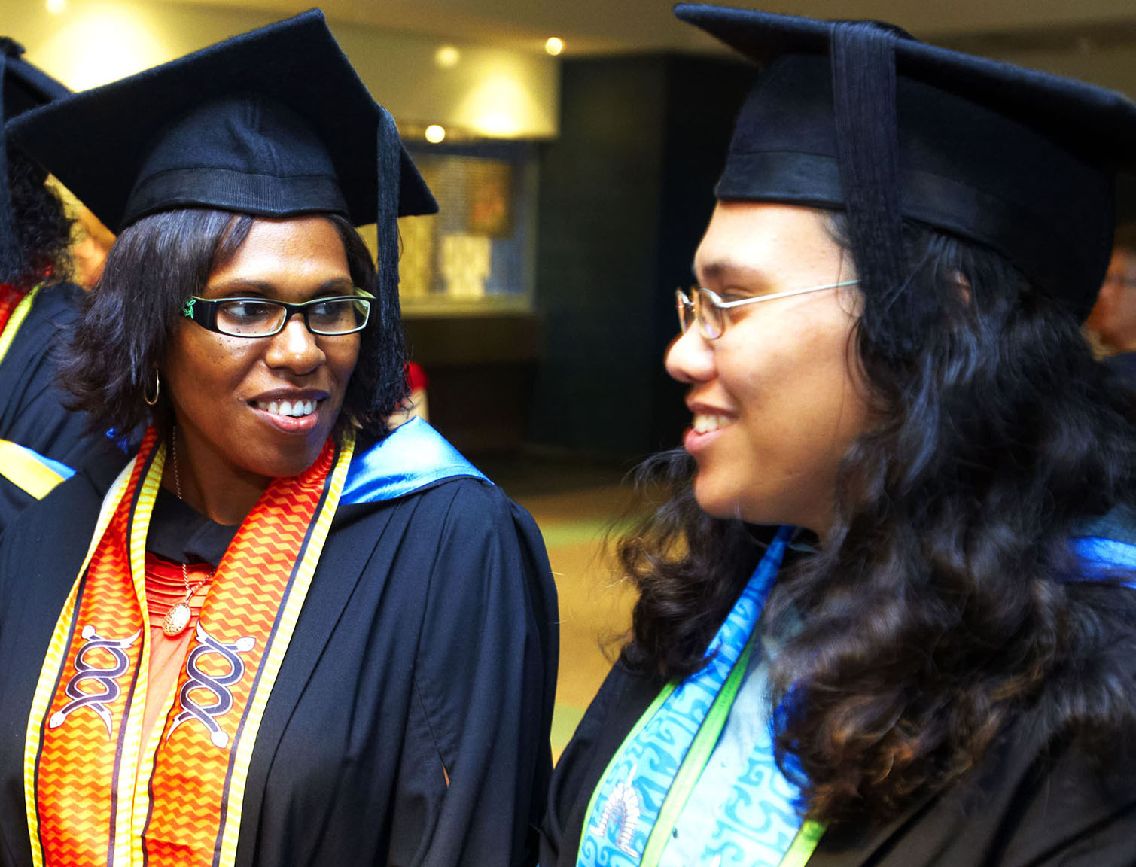
Diverse Backgrounds
Previous experience in education
Competing priorities – family, community, employment
First in family
Age and family demographics
Financial status
Language diversity

Slide 13
Challenges from research and beyond
Regular reports of ignorance and racism from both school/faculty staff and other students and during professional experience
need to recognise historical context – vocarious racism
micro-aggressions
perception is “real” when it has effects

Slide 14
Challenges from research and beyond
Importance of relationships
Isolation as a risk factor (both cultural and geographic)
Recognition of “historical baggage”
Begin positioned as “the Indigenous intern”
May be seen as deficit – especially where clients “difficult”
Contradictory responses
Challenge of transforming practice!!!

Slide 15
A common theme
The importance of professional experience sites that are culturally safe
The importance of professional development of staff in professional experience offices, especially in family relationships

Slide 16
Implications for you?
In your groups, consider the discussion so far and identify the implications of for your work:
What do you already do;
What changes could you make;
What changes can you advocate for in your context?

Slide 17
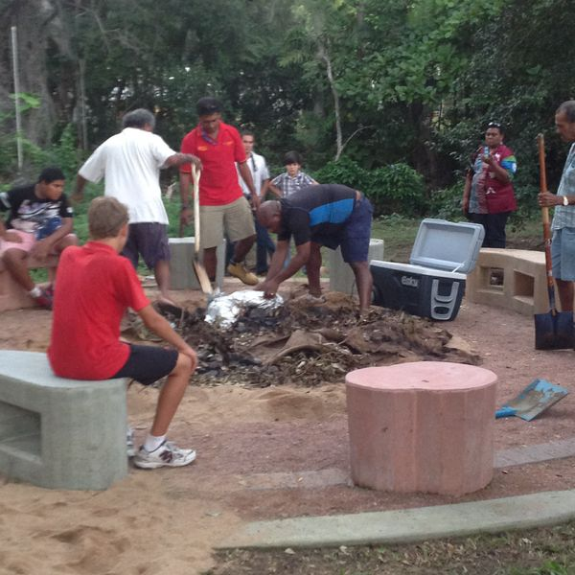
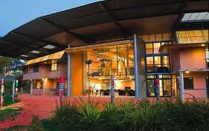
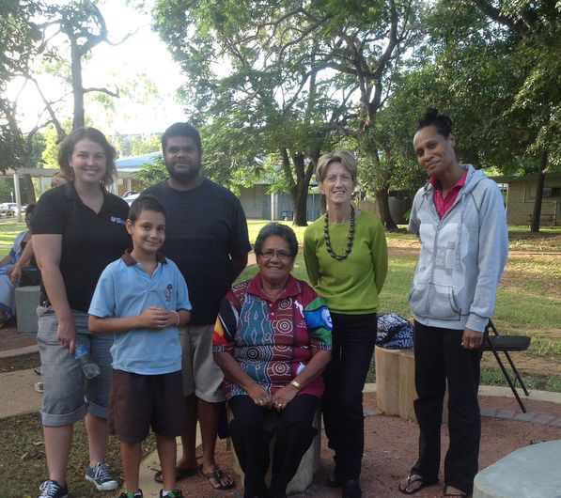
Who can you call?

Slide 18
Example of change: Navigating new identities:
Indigenous teacher aides moving to preservice teacher status
Helen McDonald & Angela Hill

Slide 19
ALTC Project questions
What combination of curriculum and pedagogic practices secures successful WIL experiences and learning outcomes?
How practices are best enacted before, during and after practice‐based experiences?
What particular curriculum and pedagogic practices are likely to secure knowledge required for effective professional practice?
Notes:
The ALTC project questions that Stephen asked us to explore are listed here. For the project that Helen and I are working on, we focused on questions 2 and 3. WE had probably asked similar questions about our practice as teacher educators in the past, but this project sharpened the ways in which we

Slide 20
Our focus
RATEP program: community based
Indigenous students in Bachelor of Education
Year 1 of uni
All have completed a TAFE qualification - Diploma of Education (ATSI)
Attend residential school
Weekly Collaborate sessions
Participate in ½ day per week placement in schools commencing week 3
Builds to a two week placement later in the year
Notes:
In i=our first session with Stephen we were asked to identify the ‘teaching and learning problem”
We chose to work with the RATEP program: a highly successful program for Indigenous students in communities outside our major regional centres
While completion rates in the program are good, progression rates are slow. Students often juggle are range of issues as they proceed through the program, and so in this small project we looked to refocus on the commencing cohort and consider what curriculum responses might improve their experiences.
Talk about slide

Slide 21
Why might others be interested in what we did…
Need to increase successful participation of Indigenous students in higher education
Movement between the education sectors- VET and higher education is significant and likely to increase
Much research indicates, despite long history of placements, teacher education does not integrate the placements and university components very successfully

Slide 22
What did we do?
Made use of residential block to prepare students in different ways
Conducted a survey about students’ experiences on placement and the preparation they received during the residential
Followed up on students’ performance in subject

Slide 23
Focus on pre-placement experiences
We designed activities in recognition that
“Smooth transition to practice – most likely realised by graduates who are informed, prepared both canonically and situationally, and exercise personal agency and critical insights”
(Billett, 2009)

Slide 24
Pre- placement activities
Previous
Focus on technical aspects of placement
When
Where
With whom
How to behave
Rules
Safety
Reporting
Compliance etc
Our trial
Shift to activities that considered
Nature of learners: Indigenous, employed, community based,
Critical engagement with students’ historical positioning in community
Shift from teacher aide – to preservice teacher
+ Technical requirements

Slide 25
Revised pre-placement activities (pedagogy)
Transition to preservice teacher
Extent continuum
To what extent will undertaking placement as a preservice teacher be the same or different to working as a teacher aide?
Compare and contrast QCT professional standards
Highlighter pen using colours to mark up what was similar and different
Review of job descriptions: teacher aides and teachers
Reflecting on historical positioning
Group picture of experience of education in community: who were teachers, community relationships, levels of education, education facilities in community
Review of extract of research report: the importance of Indigenous teachers in Indigenous communities
Prepare an action plan for placement

Slide 26
Our aims with these activities
Provide a reflection tool to engage with the historical experiences of Indigenous workers in community schools and issues of identity as a professional
Ease and improve the transition to preservice teacher status

Slide 27
The tasks we set to support reflection on their Indigenous worker status within the school
Suggested to us:
that students had previously only minimally engaged with their historical positioning as Indigenous people within the school setting, and as teacher aides with significant community links.
provided a catalyst for some students to consider their historical positioning

Slide 28
The tasks we set to prepare students in thinking through the transition from para- professional to preservice teacher
Suggested to us that:
Explicit teaching focus on this area-eg examination of job descriptions and professional standards- promoted considerable reflection on the identity shift required
Initial activity (extent continuum) provided evidence that students had little notion of the identity shift required. This contrasted with the highlighter pen activity where students were clearly able to map the differences (with some surprise) .

Slide 29
The task we set to for students to develop their own action plans
Suggested to us that:
This provided opportunities for students to identify technical requirements of professional experience within the context of greater understanding of the work of a professional.
Would this be a better way to prepare all students?

Slide 30
Conclusions
The extent to which the repositioning is required for minority groups appears to have been ignored
Transitions such as teacher aide to teacher require significant re-conceptualisation
Ideally a focussed activity to support the supervisor/workplace in reframing their positioning/perception of the Indigenous worker is required

Slide 31
Remember
“exercise personal agency and critical insights” to succeed in their degree.

Slide 32
Non-Indigenous students in Indigenous community contexts

Slide 33
What are your policies and challenges?
Group discussion

Slide 34
Indigenous community contexts
Historical factors – “white” professionals, Aboriginal and Torres Strait Islander helpers
High turnover of non-Indigenous staff
Limited accommodation
Often sites of obvious social problems and sometimes deficit discourses
Community languages

Slide 35
So, how do we prepare students for the experience?
Your suggestions?

Slide 36
Community specific considerations
Previous studies to understand historical context
Linguistic awareness
Understanding of community protocols
Need for competence
However, most research shows that professional experience in Indigenous communities most successful when combined with well designed reflection/ debriefing activites with mentor

Slide 37
Final discussion/ comments

Slide 38
According to Behrendt
Higher education and training has a critical role to play in improving the socio- economic position of Aboriginal and Torres Strait Islander people, their families and their communities. It also has an important role to play in driving the nation’s social and economic development.
Congratulations on your willingness to play a part in this!

