Slide 1
Good Practice in WIL:
challenges and opportunities
Emeritus Professor Judyth Sachs

Slide 2
Reflect on your experience of WIL
What comes to mind?
Was it as a student?
In your role at your institution?
What do you remember?
What did you get out of it?
What advice would you give to
Others about your experience?
Did it meet your expectations?
What did you learn?

Slide 3
Questions shaping presentation
What is Good practice in WIL?
How is WIL Defined?
What are the enablers for effective WIL?
What are the challenges in implementing effective WIL?

Slide 4
Organisation of Presentation
WIL Good Practice 2016 report
Characteristics of Good Practice
Challenges and opportunities regarding WIL
WIL in Practice – Case Study PACE at Macquarie

Slide 5
What is the focus of WIL?
Employability?
Students gaining an experience of work?
Applying learning in a workplace setting?
Personal transformation?

Slide 6
Defining good practice?
Effective and successful
Mutual benefit
Reciprocity and trust
Authentic
Inclusive
Applied learning
Replicable and adaptable
Monitoring & evaluation
Integration
Innovation

Slide 7
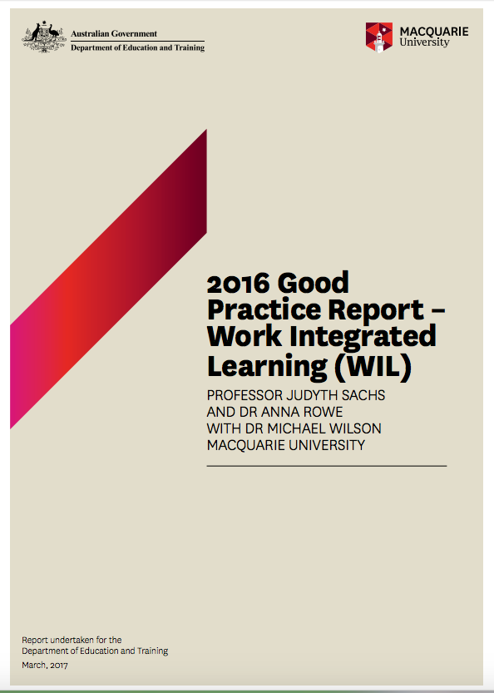

Slide 8
http://hdl.voced.edu.au/10707/428798.
Where to find the report and case studies

Slide 9
WIL Good Practice Project 2016
Where we started
National Strategy on Work Integrated Learning in
University Education
How we approached this:
Update on Orrell’s 2011 ALTC Report on WIL
Review of contemporary literature on WIL
40 case studies describing WIL in practice
13 Australian and 2 international universities

Slide 10
Organisation of report
+ 40 case studies
WIL defined, models and benefits
Approaches to WIL
Curriculum matters
Student experience and managing diversity
Partnerships and stakeholder management
Conclusions and recommendations

Slide 11
Defining WIL
What does the literature say?
WIL has been used in many ways to refer to
various types of education-work experiences.
It is often used interchangeably withother terms
such as work-based learning, cooperative
education and experiential
education/learning.
WIL remains somewhat of an “ill-defined
concept which can present a “problem
of definition”. (Orrell 2011)

Slide 12
WIL
How is it defined?
Earlier definitions conceived of WIL as a “strategy in
which students undergo conventional academic learning
and combine this learning with some time spent in a
workplace relevant to their program of study and career
aims” (Coll et al., 2009 p. 14).
Patrick et al. (2008) extended this notion, proposing
WIL as “an umbrella term” for a range of approaches,
practices and strategies seeking to incorporate theory
with the practice of work within “a purposefully designed
curriculum” (p.9

Slide 13
General observations
Need to find an
alternative term to
describe programs to
enhance employability
WIL terminology not
understood outside
universities

Slide 14
Findings
WIL exists in a variety of forms
across various universities,
disciplines & programs
One size does not fit all
WIL can
be an integral part of university strategy
operate across the whole university
be discipline specific
Notes:
University strategy – Macquarie, RMIT, Swinburne, Curtin
Discipline specific – QUT – creative industries, Melbourne Science, USQ Psychology

Slide 15
Findings
Organisationally WIL is:
well-governed, resourced and supervised
prioritised by the institution and has institutional/faculty/
departmental buy-in/investment
has its institutional and industry-based champions
meaningful and accessible to all stakeholders
intentionally linked to and supports learning outcomes,
especially around employability

Slide 16
Challenges
Whole of university commitment
Compulsory or elective WIL
Delivering to large cohorts
Simulations and virtual WIL
Student research and project work
Paid and unpaid
Notes:
Delivering – on campus, on line, face to face, virtual through simulations
Curriculum renewal – Macquarie, Monash Science and UTS used curriculum renewal as the stimulus to integrate WIL into the curriculum
Enablers – policies and procedures, placement management systems InPlace, resources and support

Slide 17
Challenges
Student experience and diverse populations
Finding a WIL placement
International WIL experiences
International students and WIL
Inclusive WIL

Slide 18
Challenges
Curriculum Matters
Integrating into the curriculum is a shared understanding between
all stakeholders as to the purpose of the activity, the requirements of
quality supervision, appropriate task allocation, effective student
preparedness and authentic assessment practices (Patrick et al 2008)
Assessment – assessing a broad range of skills and capabilities
outside of classroom learning – authentic assessment
An integrated approach
Preparation
WIL Experience
Debrief

Slide 19
Challenges
Managing multiple stakeholders
A shared vision, mutual
respect, commitment,
collaboration, trust,
coordination, adaptive
practices & co-generative
learning.
Effective communication
Managing expectations
Providing feedback

Slide 20
Opportunities
Curriculum renewal and course differentiation
Rethinking delivery and pedagogy
WIL can be experienced in physical and virtual spaces
online and offline environments, on-campus or
off-campus.
Relationships with industry partners provides
opportunities for research, institution profile,
employment for graduates
Learning in the workplace is not just for the
academically gifted. It is for all students. It is a
philosophy that rewards achievement without
disadvantaging difference

Slide 21
Integrated skills

Slide 22
Macquarie University PACE
the practical component in all of Macquarie’s undergraduate degrees
lets students gain real-world experience before they graduate – enhancing their employability
students apply their studies in real settings – and get academic credit for it
activities benefit students and partners simultaneously: through PACE students make an active contribution to society

Slide 23
PACE units – common elements
community engagement: mutually beneficial partnership that helps partner achieve their mission: reciprocity as a central value
rigorous academic framework to develop key graduate capabilities
ORIENTATION
organisational/admin requirements
expectations
preparatory sessions
any preparatory assessment tasks
PACE ACTIVITY
experience itself
assessment tasks
monitoring of learning outcomes
FINAL WRAP-UP
debrief
any post-experience assessment tasks
evaluation
Scaffolding for skills development
SCAFFOLDING FOR SKILLS DEVELOPMENT INCLUDING REFLECTIVE PRACTICE

Slide 24
Thank you!
Over to you for questions

